Slide 1
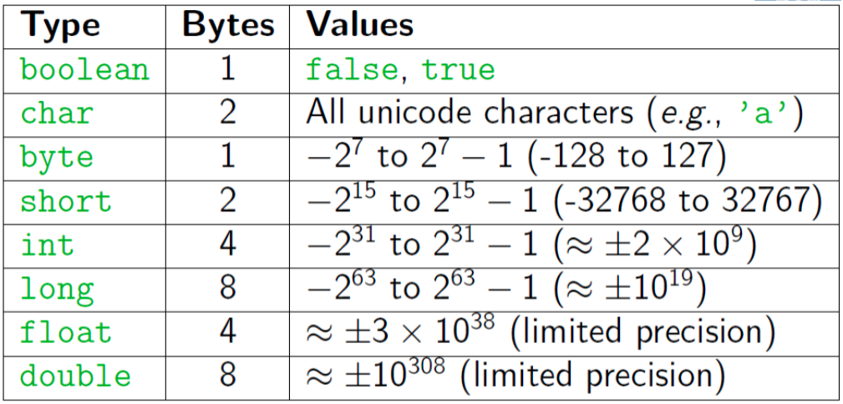
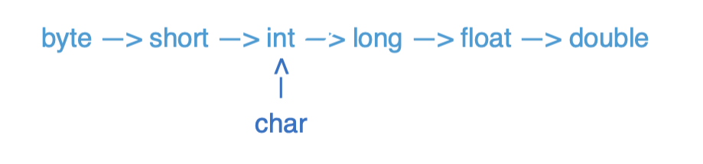
Java Types

Slide 2
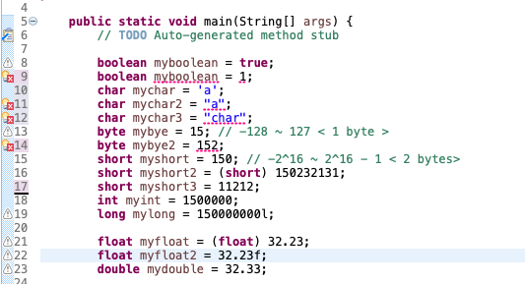
Java Types

Slide 3
Pre/Post Increment/Decrement
Pre-Increment/Decrement
++x/--x: returns the increment/decrement number and x becomes the increment/decrement number
Post-Increment/Decrement
x++/x--: returns the original number and x becomes the increment/decrement number
x == 8
++x == 9
x == 9
x == 4
--x == 3
x == 3
x == 8
x++ == 8
x == 9
x == 4
x-- == 4
x == 3

Slide 4
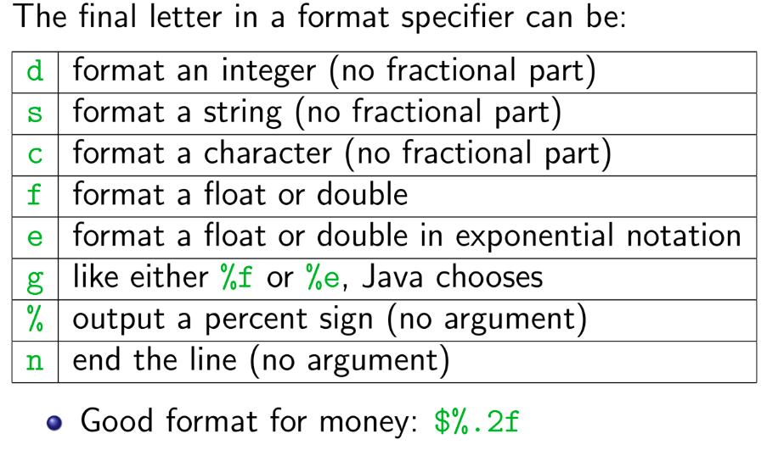
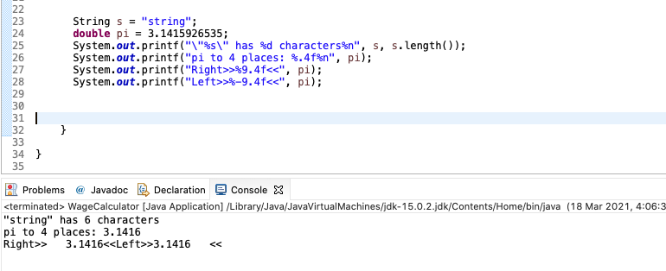
printf
Printf is like print, but it lets you control how data is formatted
Method from System.out.printf(format-string, args)
Example: System.out.printf(“Avarage: %5.2f”, average)
Format String: %X.Y
X is the minimum number of characters to be printed
Y is the number of digits of the value to print after the decimal point

Slide 5
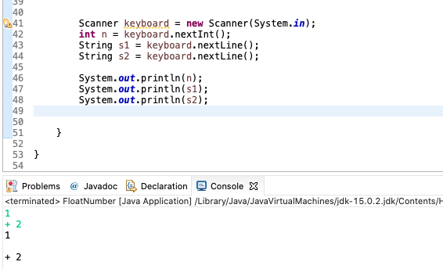
Scanner
Get from Console: Scanner keyboard = new Scanner(System.in);
Get from File: File text = new File("C:/temp/test.txt");
Scanner scanner = new Scanner(text);
.nextLine() reads the rest of the whole line as string
.next()/ .nextInt() / .nextDouble() reads until whitespace

Slide 6
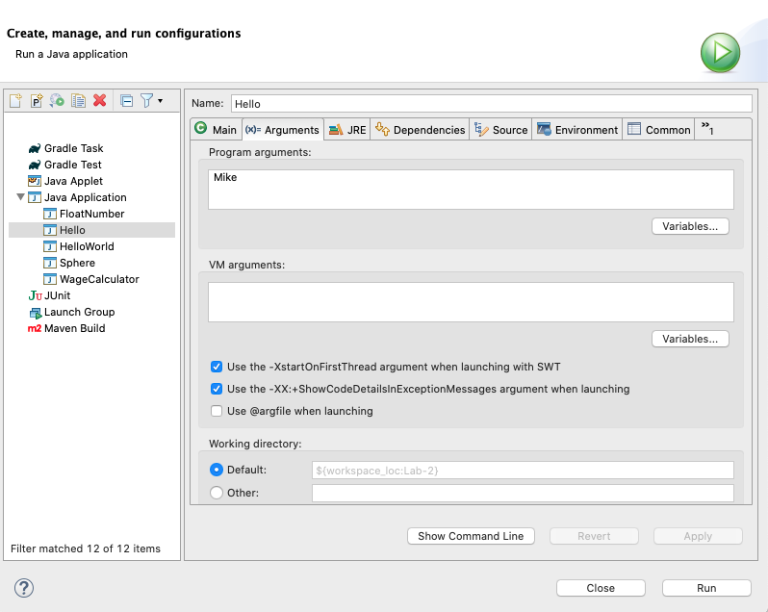
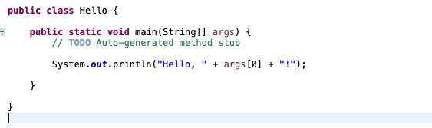
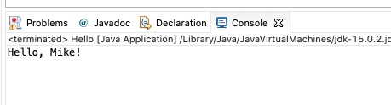
Command Line inputs/arguments
First argument: args[0], second argument: args[1]
Each of these arguments is a string (need to convert to other types for use)

Slide 7
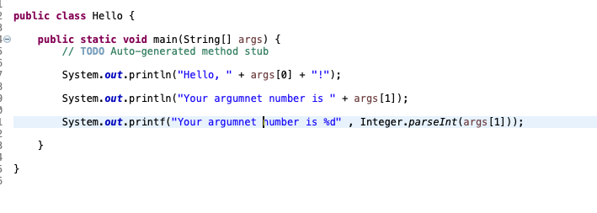
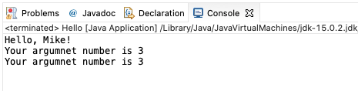
Command Line inputs/arguments
Convert to int
Integer.parseInt(String)

Slide 8
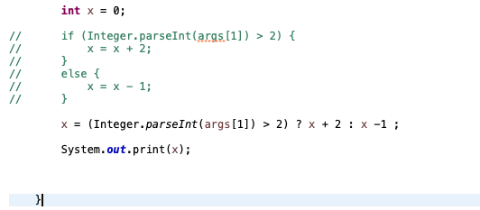
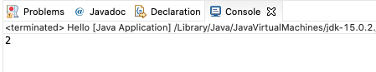
Conditional Operator
Alternative for if-else statement

Slide 9
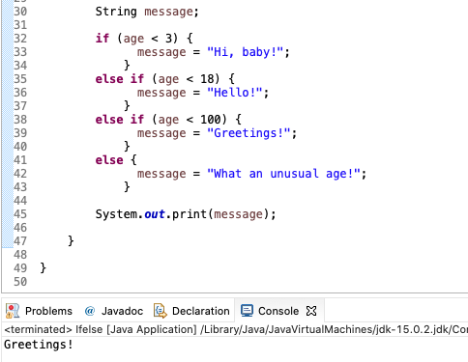
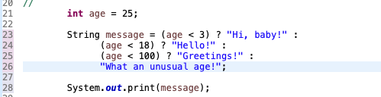
Conditional Operator
If - else if – else statement VS Conditional Operator

Slide 10
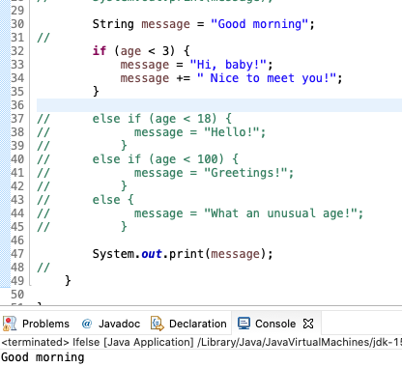
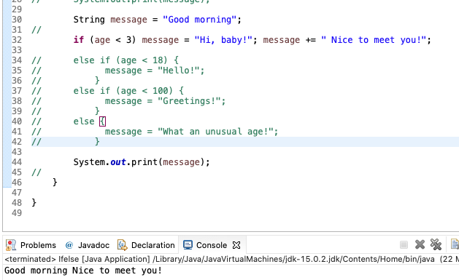
Compound statement
Turns multiple statements into a single statement that can be used in an if.
A good suggestion: Always use braces!
Always use indentation to make your code easy to read

Slide 11
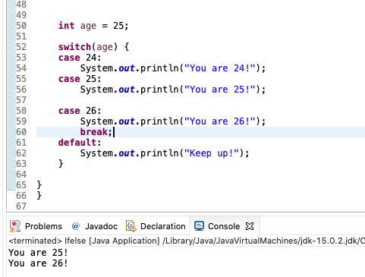
Switch
It begins executing with the next statement and stops when it reaches a break or end of the switch.
Always put break after each statement including default

Slide 12
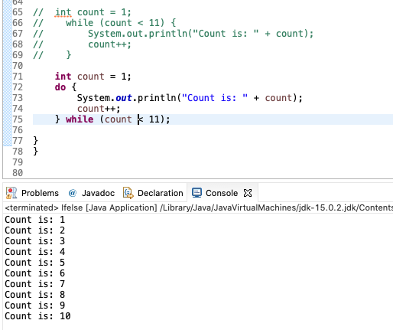
While VS do-while
While
entry control loop
condition is checked before loop execution
never execute loop if condition is false
there is no semicolon at the end of while statement
Do-While
exit control loop
condition is checked at the end of loop
executes false condition at least once since condition is checked later
there is semicolon at the end of while statement.

Slide 13
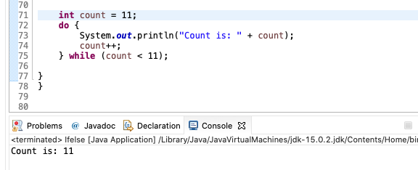
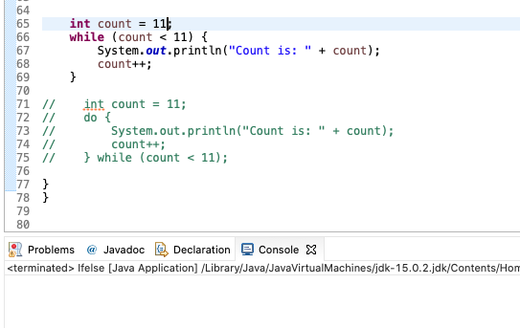
While VS do-while

Slide 14
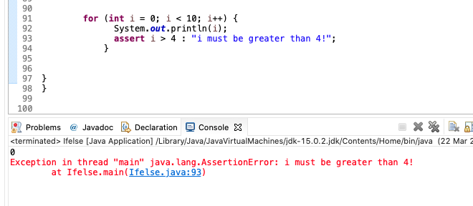
Assert
Check for some must meet condition!
Not common use
Enable Asset in Eclipse

Slide 15
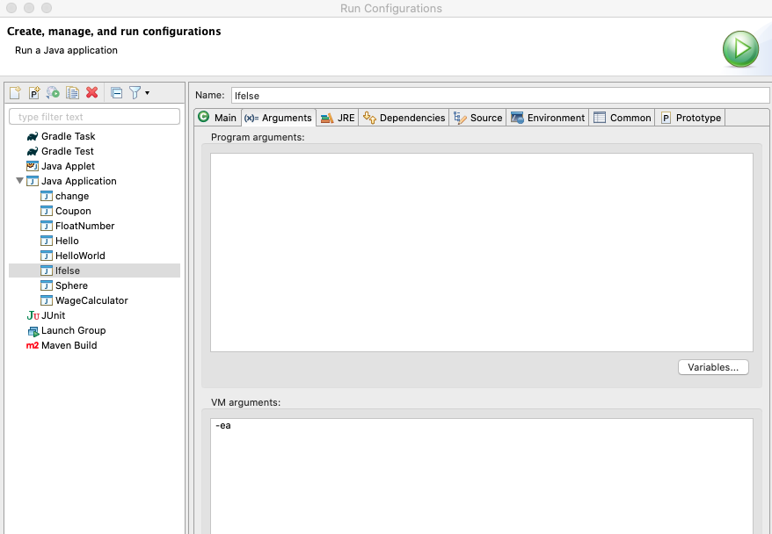
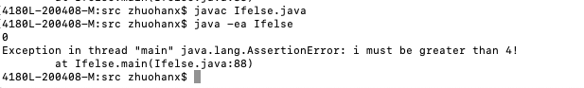
Assert
Check for some must meet condition!
Not common use
Enable Asset in Eclipse or Terminal

Slide 16
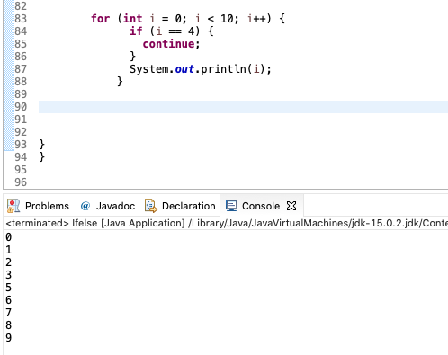
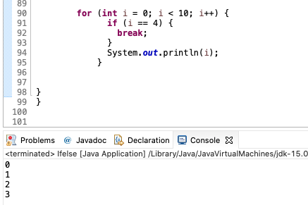
Continue VS Break
Continue passes one iteration; break breaks out of the whole loop

Slide 17
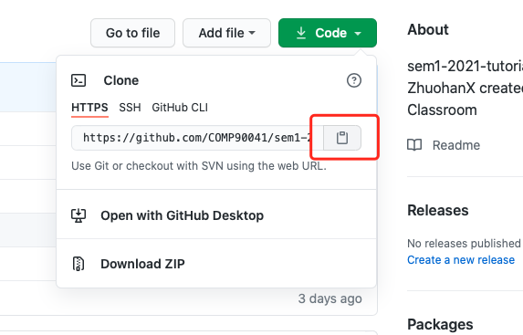
Git Clone a repository
Copy the link!

Slide 18
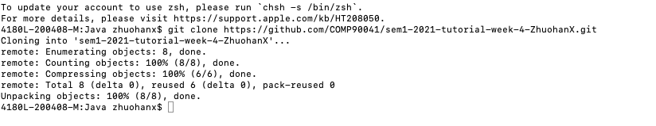
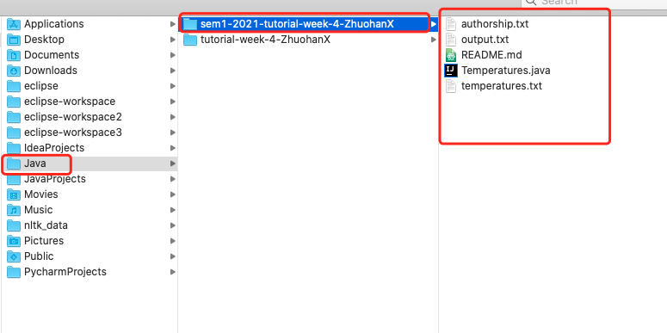
Git Clone a repository
Open a terminal at the suitable location and use git clone (link)

Slide 19
Import from File System and Edit Your Code

Slide 20
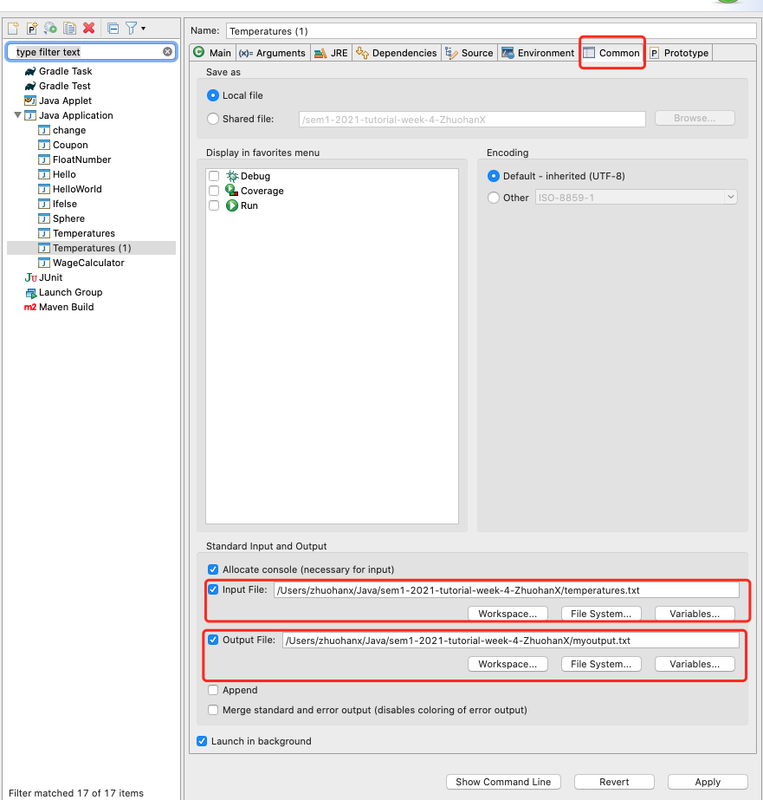
Run code with file input and output
Eclipse: Run configuration > Common > Input File and Output File.
Terminal : Java (Class) < (input file) > (output file)
Command can be separated (use only input or output)

Slide 21
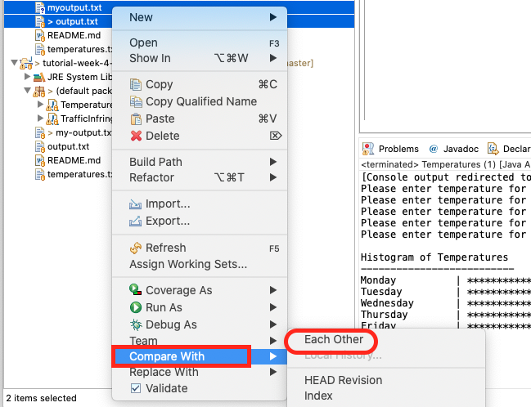
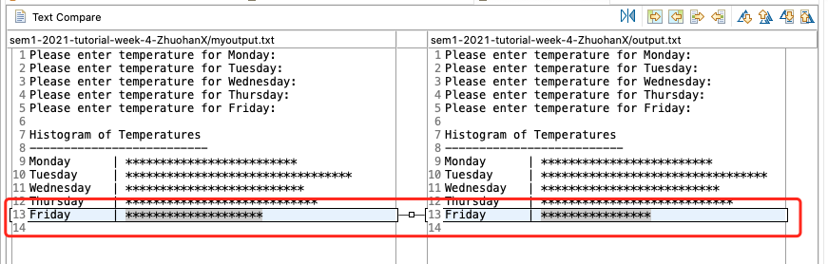
Compare the Differences
Eclipse: Select two files and use compare with each other

Slide 22
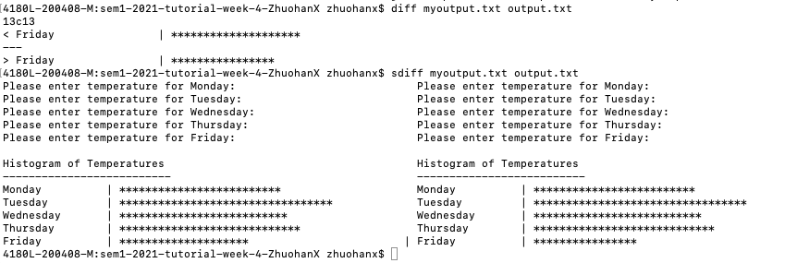
Compare the Differences
Terminal command: sdiff and diff

Slide 23
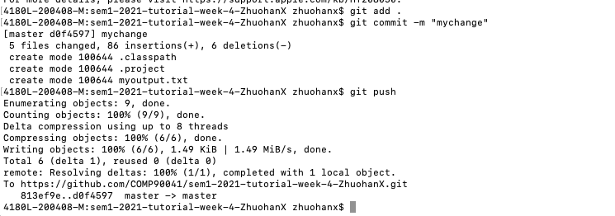
Commit code change and push
Add all your changed code files (. Means all)
Commit with commit message (for yourself to check)
Push to the remote repostitory

Slide 24
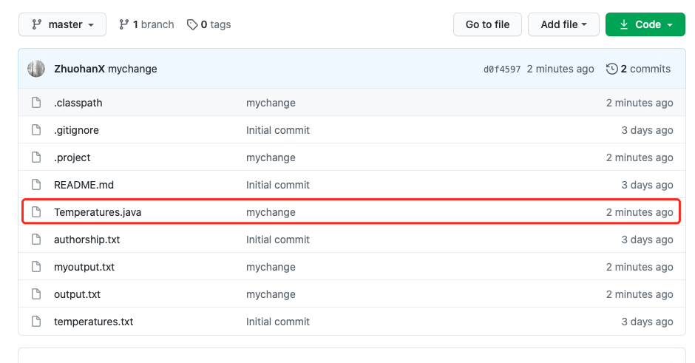
Commit code change and push
Updated file shows message and time!

Slide 25
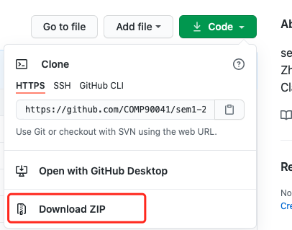
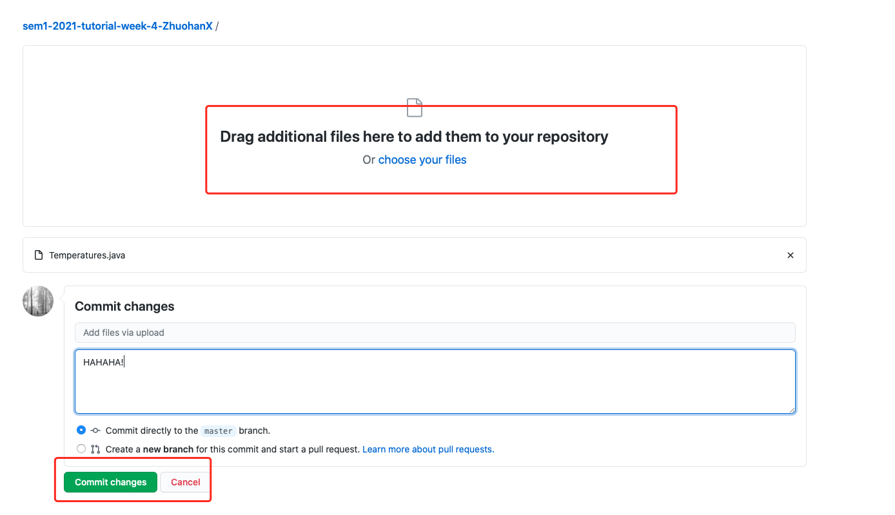
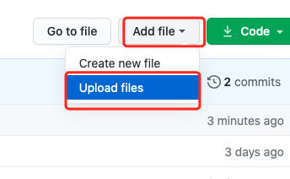
Do everything on Website
Download Code and Edit and drag your files and commit on webpage.

Slide 26
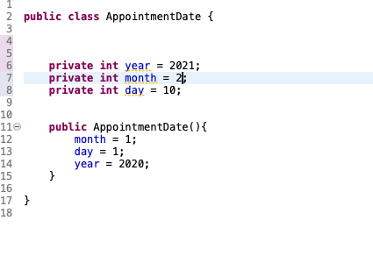
Classes and Methods
A Java program consists of objects from various classes interacting with one another
Every program is a class
Class is a type that you can declare variables of a class type
Object or instance of the class is the value of a class type
Car mycar = new Car();
Object has both data and actions (methods).
All objects of the same class might have different data value, but the same data type and methods.
A primitive type value is a single piece of data
A class type object can have multiple pieces of data and methods.

Slide 27
Methods
Method consists of a heading and a method body
Methods are invoked using the name of the calling object or class name and the method name
Class.method(); or classvar.method();
Method can compute and return a type value or just perform an action and no return (void method)
A program in Java is a class that contains a main method (a void method)
public static void main(String[] args)

Slide 28
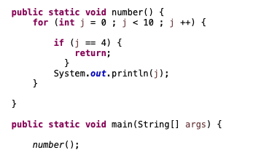
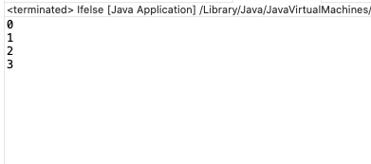
return
The body of a method that returns a value must contain one or more return statements
A return statement specifies the value returned and ends the method invocation: return Expressions;
A void method need not contain a return statement but can use return to end the code.

Slide 29
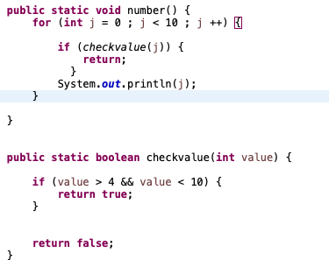
Use returned value
A invocation of a method that returns a value can be used anyplace that a value of the RetrunedType can be used.
An invocation of a method that returns a value of type boolean returns either true or false, usually used in if-else statement or while loops.

Slide 30
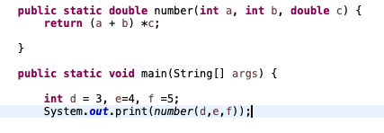
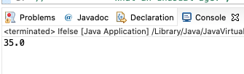
Parameter and argument
A parameter list provides a description of the data required by a method
It indicates the number and types of data pieces needed, the order they must be given and the local name for these pieces as used in the method
Argument is the appropriate values passed to the method (Actual parameters)
The number and order of arguments must exactly match that of the parameter list
If types do not match, Java will try to make an automatic type conversion
call-by-value: value of each argument is passed into the method parameter not name

Slide 31
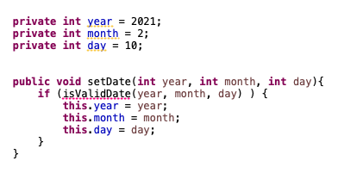
this
this parameter is a hidden parameter
this must be used if local variables have the same name with the instance variables, otherwise all variables will be interpreted as local

Slide 32
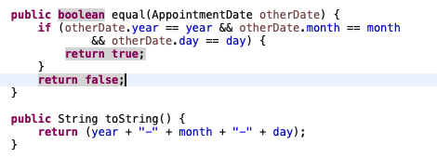
equal and toString
Java expects certain methods such as equal and toString
equal is to compare if the two objects of the class type are the same
toString can be used to display the value of the object

Slide 33
Testing methods
Driver program: A program with only purpose to test a method
Bottom-up testing: For some method that invokes other methods, First test all methods it invokes and then test such method

Slide 34
Information hiding and Encapsulation
Information hiding is the practice of separating how to use a class from the details of its implementation
Abstraction is another term used to express the concept of discarding details in order to avoid information overload
Encapsulation means that the data and methods of a class are combined into a single unit (i.e., a class object), which hides the implementation details
The API or application programming interface for a class is a description of how to use the class
An ADT or abstract data type is a data type that is written using good information-hiding techniques

Slide 35
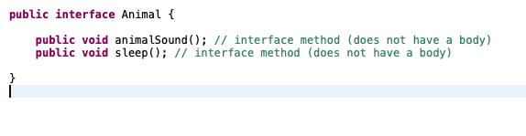
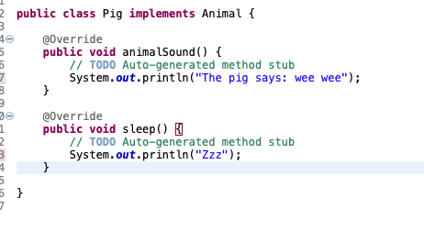
Interface

Slide 36
public and private
public means that there are no restrictions on where an instance variable or method can be used
private means that an instance variable or method cannot be accessed by name outside of the class
It is considered good programming practice to make all instance variables private
Most methods are public, and thus provide controlled access to the object
Usually, methods are private only if used as helping methods for other methods in the class

Slide 37
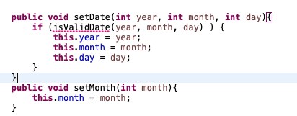
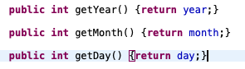
Accessor and Mutator
Accessor methods allow the programmer to obtain the value of an object's instance variables (getter)
Mutator methods allow the programmer to change the value of an object's instance variables in a controlled manner (setter)

Slide 38
Overloading
Overloading is when two or more methods in the same class have the same method name
A signature consists of the name of a method together with its parameter list (not include the returned type)
To be valid, any two definitions of the method name must have different signatures
Java does not permit methods with the same name and different return types in the same class

Slide 39


Overloading

Slide 40
Constructor
Constructor is a special kind of method that is designed to initialize the instance variables for an object
A constructor must have the same name as the class
A constructor has no type returned, not even void
Constructors are typically overloaded
A constructor is called when an object of the class is created using new

Slide 41

Constructor

Slide 42
static methods and variables
A static method can be used without a calling object, need to use the keyword static
public static returnedType MethodName(parameters…)
A static method is invoked using the classname.methodname()
A static method has no this inside the method, so it cannot refer to an instance variable of the class or invoke a non-static method of the class, but it can invoke another static method
A static variable is a variable that belongs to the class as a whole, not just to one object.
Only one copy of a static variable per class, unlike instance variable where each object has its own copy
All objects of the class can read and change a static variable
Static method can access a static variable
Math class has a lot methods you can call using Math.methodnames()

Slide 43
Wrapper classes for primitive types
Wrapper classes provide a class type corresponding to each of the primitive types and makes it possible to have class types that behave somewhat like primitive types.
Boxing: go from a primitive type to an object of its wrapper class
Unboxing: go from an object of wrapper class to the corresponding value of a primitive type
Boxing: Integer integerObject = new Integer(2);
Unboxing: int i = integerObject.intValue();

Slide 44
Wrapper classes for primitive types
Wrapper classes provide a class type corresponding to each of the primitive types and makes it possible to have class types that behave somewhat like primitive types.
Boxing: go from a primitive type to an object of its wrapper class
Unboxing: go from an object of wrapper class to the corresponding value of a primitive type
Boxing: Integer integerObject = new Integer(2);
Unboxing: int i = integerObject.intValue();

Slide 45
Variables and Memory
Second memory is used to hold files for “permanent” storage
Main memory (primary memory) is used by the computer when running a program
Values in a program are kept in main memory
Main memory consists of a long list of numbered locations called bytes
Address: the number that identifies a byte
Values of most data types require more than one byte of storage and the
Address of the first byte of this memory location is used as the address for the data
When the variable is a primitive type, the value of the variable is stored in the memory location, each primitive type always require the same amount of memory to store its values
When the variable is a class type, only the memory address (or reference) where the object is located is stored in the memory location

Slide 46


Slide 47
Class Assignment and Parameters
Two reference variables can contain the same reference, assignment sets the reference to the same object
variable1 = variable2;
A method cannot change the value of a variable of a primitive type that is an argument to the method
In contrast, a method can change the values of the instance variables of a class type that is an argument to the method.
== operator checks that two class type variables have the same memory address
equals checks two class type variables have the same data values (often write by yourself)
null is a ”placeholder” for a reference that does not name any memory location, it is like a memory address, use == or != not equals

Slide 48




Slide 49
Immutable and mutable Class
A class that contains no methods (other than constructors) that change any of the data in an object of the class is called an immutable class (String class is an immutable class)
Objects of such classes are called immutable objects
A class that contains public mutator methods or other public methods that can change the data in its objects is called a mutable class
Objects of which are mutable objects

Slide 50
Deep and Shallow Copy
A copy constructor is a constructor with a single argument of the same type as the class
A deep copy of an object is a copy that with one exception has no references in common with the original. Exception: References to immutable objects
Any copy that is not a deep copy is called a shallow copy
Privacy leak: Shallow Copy without create a new instance variable for mutable class or return a mutable object can cause privacy leak. The values can be changed by others

Slide 51
Arrays
An array that behaves like this collection of variables, all of type double, can be created using one statement as follows:
double[] score = new double[5];
Use index score[0], score[1], score[2], score[3], score[4] to get the number 1, 2, 3, 4, 5 of the element.
An array is declared and created in almost the same way that objects are declared and created
BaseType[] ArrayName = new BaseType[size];
Usually use a for loop to go through an array.
Array is an object and has an instance variable: length.
score.length is 5.
Index is from 0 to length-1, other indexs would cause an out-of-bounds error.
Initialize with declare: int[] age = {2, 12, 1} (age.length is 3)
Or initialize with a for loop
If not initialized, they will automatically be initialized to the default value for their base type

Slide 52

Arrays

Slide 53
Arrays and Reference
Arrays are objects
A variable of an array type holds the address of where the array object is stored in memory
Since an array is a reference type, the behavior of arrays with respect to assignment (=), equality testing (==), and parameter passing are the same as that described for classes
the assignment operator (=) copies this memory address
the equality operator (==) tests two arrays share the same address, not values.
Need to write methods to check length and each values to check if they are equal.
The heading for the main method of a program has a parameter for an array of String
You can return an array in the method.
Date[] holidayList = new Date[20];
Each of these indexed variables are automatically initialized to null
for (int i=0; i<holidayList.length; i++) { holidayList[i] = new Date(); }
Both array indexed variables and entire arrays can be used as arguments to methods

Slide 54

Arrays and Reference

Slide 55




Arrays and Reference

Slide 56
Command Line inputs/arguments
First argument: args[0], second argument: args[1]
Each of these arguments is a string (need to convert to other types for use)

Slide 57




Arrays and Reference

Slide 58




for-each loop to go through array

Slide 59


Avoid privacy leak for array
Array is a mutable object, don’t give an array directly, but create a new one and copy all values.

Slide 60

Selection Sort in Array

Slide 61

Selection Sort in Array

Slide 62


Selection Sort in Array

Slide 63


Enumerated Type
Work likes String but one variable can only be set to within the fixed items. Perfectly fit with switch

Slide 64


ArrayList
An object that can works like array, but change length and less effeciently.
The class ArrayList is implemented using an array as a private instance variable – When this hidden array is full, a new larger hidden array is created and the data is transferred to this new array
An ArrayList is less efficient than an array It does not have the convenient square bracket notation The base type of an ArrayList must be a class type or interface type (or other reference type): it cannot be a primitive type
ArrayList come with many powerful methods you can use.

Slide 65
Multidimendional Arrays
Multidimensional arrays are declared and created in the same ways as one-dimensional arrays.
double[][]table = new double[100][10];
int[][][] figure = new int[10][20][30];
Person[][] = new Person[10][100];
Two-dimensional array is array of arrays
char[][] page = new char[30][100];
page.length is equal to 30
page[0].length is equal to 100
Ragged array: an array that has a
different number of elements per row

Slide 66

Multidimendional Arrays

Slide 67

Multidimendional Arrays

Slide 68


Multidimendional Arrays

Slide 69

Unified Modeling Language(UML)
A type of structure diagram
Describe the structure of a system by showing the system’s classes, attributes, methods and relationship.
The data specification for each piece of data in a UML diagram consists of
its name, followed by a colon, followed by its type
Each name is preceded by a character that specifies its access type:
A minus sign (-) indicates private access
A plus sign (+) indicates public access
A sharp (#) indicates protected access
A tilde (~) indicates package access
Missing members are indicated with an ellipsis (three dots)
UML has various ways to indicate the information flow from
one class object to another using different sorts of annotated arrows
UML has annotations for class groupings into packages,
for inheritance, and for other interactions

Slide 70

Multidimendional Arrays

Slide 71


Slide 72
package
Java uses packages to form libraries of classes
A package is a group of classes that have been placed in a directory or folder, and that can be used in any program that includes an import statement that names the package
The import statement must be located at the beginning of the program file
import java.util.Scanner; to use Scanner object
import java.util.* makes all the classes in a package available instead of just one class
Drawbacks of using *
Worse readability of code due to lack of info of which package is used
Possibly longer compilation time
Larger possibility of conflict of package names with other
To make a package, group all the classes together into a single directory (folder), and add the following package statement to the beginning of each java file for those classes
package package_name;
Only the .class files must be in the directory or folder, the .java files are optional
Only blank lines and comments may precede the package statement
If there are both import and package statements, the package statement must precede any import statements

Slide 73
CLASSPATH
Java needs two things to find the directory for a package: the name of the package and the value of the CLASSPATH variable
When a package is stored in a subdirectory of the directory containing another package, importing the enclosing package does not import the subdirectory package
import utilities.numericstuff.*;
import utilities.numericstuff.statistical.*;
All the classes in the current directory belong to an unnamed package called the default package
As long as the current directory (.) is part of the CLASSPATH variable, all the classes in the default package are automatically available to a program
If the CLASSPATH variable is set, the current directory must be included as one of the alternatives
If the CLASSPATH variable is not set, then all the class files for a program must be put in the current directory
The class path can be manually specified when a class is compiled
add –classpath followed by the desired class path will compile the class, overriding any previous CLASSPATH setting
use the –classpath option again when the class is run
packages provide a way to deal with name clashes: a situation in which two classes have the same name
This ambiguity can be resolved by using the fully qualified name (i.e., precede the class name by its package name) to distinguish between each class
package_name.ClassName

Slide 74
javadoc
Java has a program called javadoc that automatically extracts the interface from a class definition and produces documentation
The javadoc program extracts class headings, the headings for some comments, and headings for all public methods, instance variables, and static variables
In the normal default mode, no method bodies or private items are extracted
To extract a comment, the following must be true:
The comment must immediately precede a public class or method definition, or some other public item
The comment must be a block comment, and the opening /* must contain an extra*(/** . . . */)
In addition to any general information, the comment preceding a public method definition should include descriptions of parameters, any value returned, and any exceptions that might be thrown

Slide 75
Inheritance
Inheritance is one of the main techniques of object-oriented programming (OOP)
a very general form of a class is first defined and compiled, and then more specialized versions of the class are defined by adding instance variables and methods
The specialized classes are said to inherit the methods and instance variables of the general class
Inheritance is the process by which a new class is created from another class
The new class is called a derived/child/sub class
The original class is called the base/parent/super class
A derived class automatically has all the instance variables and methods that the base class has, and it can have additional methods and/or instance variables as well
public class HourlyEmployee extends Employee
Class Employee defines the instance variables name and hireDate in its class definition
Class HourlyEmployee has additional instance variables wageRate and hours that are specified in its class definition
Inherited Members: The derived class inherits all the public methods, all the instance variables, and all the static variables from the base class
a class that is a parent of a parent . . . of another class is called an ancestor class
If class A is an ancestor of class B, then class B can be called a descendent of class A

Slide 76

Inheritance

Slide 77

Inheritance

Slide 78
Override
a derived class inherits methods from the base class, it can change or override an inherited method if necessary
the type returned may not be changed when overriding a method
if it is a class type, then the returned type may be changed to that of any descendent class of the returned type
public class BaseClass
{...
public Employee getSomeone(int someKey) ...
public class DerivedClass extends BaseClass
{...
public HourlyEmployee getSomeone(int someKey) ...
The access permission of an overridden method can be changed from private in the base class to public (or some other more permissive access) in the derived class
the access permission of an overridden method can not be changed from public in the base class to a more restricted access permission in the derived class
When a method is overridden, the new method definition given in the derived class has the exact same number and types of parameters as in the base class
When a method in a derived class has a different signature from the method in the base class, that is overloading

Slide 79
final
If the modifier final is placed before the definition of a method, then that method may not be redefined in a derived class
It the modifier final is placed before the definition of a class, then that class may not be used as a base class to derive other classes
A derived class uses a constructor from the base class to initialize all the data inherited from the base class
public derivedClass(int p1, int p2, double p3) {
super(p1, p2);
instanceVariable = p3;
}
A call to the base class constructor can never use the name of the base class, but uses the keyword super instead
A call to super must always be the first action taken in a constructor definition
An instance variable cannot be used as an argument to super
If a derived class constructor does not include an invocation of super, then the no-argument constructor of the base class will automatically be invoked
Within the definition of a constructor for a class, this can be used as a name for invoking another constructor in the same class
If it is necessary to include a call to both super and this, the call using this must be made first, and then the constructor that is called must call super as its first action
a no-argument constructor uses this to invoke an explicit-value constructor
public ClassName()
{
this(argument1, argument2);
}
public ClassName(type1 param1, type2 param2)
{ ...}

Slide 80
this
public HourlyEmployee()
{ this("No name", new Date(), 0, 0); }
public HourlyEmployee(String theName, Date theDate, double theWageRate, double theHours)
an object of a derived class has the type of every one of its ancestor classes
an object of a derived class can be assigned to a variable of any ancestor type
a derived class object can be used anyplace that an object of any of its ancestor types can be used
An ancestor type can never be used in place of one of its derived types
An instance variable that is private in a base class is not accessible by name in the definition of a method in any other class, not even in a method definition of a derived class
If private instance variables of a class were accessible in method definitions of a derived class, then anytime someone wanted to access a private instance variable, they would only need to create a derived class, and access it in a method of that class
The private methods of the base class are like private variables in terms of not being directly available
This should not be a problem because private methods should just be used as helping methods
Thanks to inheritance, most of the standard Java library classes can be enhanced by defining a derived class with additional methods

Slide 81

this

Slide 82


this

Slide 83

Access Modifiers

Slide 84
protected
If a method or instance variable is modified by protected (rather than public or private), then it can be accessed by name Inside any class derived from it
An instance variable or method definition that is not preceded with a modifier has package access
Instance variables or methods having package access can be accessed by name inside the definition of any class in the same package
It is only valid to use super to invoke a method from a direct parent
For example, if the Employee class were derived from the class Person, and the HourlyEmployee class were derived form the class Employee, it would not be possible to invoke the toString method of the Person class within a method of the HourlyEmployee class super.super.toString() // ILLEGAL!
every class is a descendent of the class Object
The class Object is in the package java.lang which is always imported automatically
some library methods accept an argument of type Object so they can be used with an argument that is an object of any class
The class Object has some methods that every Java class inherits
For example,the equals and toString methods
Every object inherits the same getClass() method from the Object class
This method is marked final, so it cannot be overridden
An invocation of getClass() on an object returns a representation only of the class that was used with new to create the object
The results of any two such invocations can be compared with == or != to determine whether or not they represent the exact same class
The instanceof operator checks if an object is of the type given as its second argument
it will return true if Object is the type of any descendent class of ClassName

Slide 85
Polymorphism
There are three main programming mechanisms that constitute object-oriented programming (OOP)
Encapsulation
Inheritance
Polymorphism
Polymorphism is the ability to associate many meanings to one method name
It does this through a special mechanism known as late binding or dynamic binding
Inheritance allows a base class to be defined, and other classes derived from it
Polymorphism allows changes to be made to method definitions in the derived classes, and have those changes apply to the software written for the base class
The process of associating a method definition with a method invocation is called binding
If the method definition is associated with its invocation when the code is compiled, that is called early binding or static binding
If the method definition is associated with its invocation when the method is invoked (at run time), that is called late binding or dynamic binding
Java uses late binding for all methods (except private, final, and static methods)
Because of late binding, a method can be written in a base class to perform a task, even if portions of that task aren't yet defined

Slide 86

Late Binding

Slide 87

Late Binding

Slide 88

Late Binding

Slide 89
Upcasting
Upcasting is when an object of a derived class is assigned to a variable of a base class (or any ancestor class)
Downcasting is when a type cast is performed from a base class to a derived class (or from any ancestor class to any descendent class)

Slide 90
Abstract Class
In order to postpone the definition of a method, Java allows an abstract method to be declared
An abstract method has a heading, but no method body
The body of the method is defined in the derived classes
The class that contains an abstract method is called an abstract class An abstract class must have the modifier abstract included in its class heading
public abstract double getPay();
public abstract void doIt(int count);
If a derived class of an abstract class adds to or does not define all of the abstract methods, then it is abstract also, and must add abstract to its modifier
A class that has no abstract methods is called a concrete class
Abstract Class and Interface
When we talk about abstract classes we are defining characteristics of an object type; specifying what an object is.
When we talk about an interface and define capabilities that we promise to provide, we are talking about establishing a contract about what the object can do.

Slide 91

Abstract Class

